Slide 1

Hakkak Investment Group
Corporate Profile

Slide 2
Background
Al-Hakkak family has been in the trading and investment business since the beginnings of the 20th century, as they were engaged in different trading activities throughout the generations.
The Sons of Hajj Karim Saleh Al-Hakkak, took the legacy of the family to a modern professional business approach, and organized the scattered activities under the Hakkak Investment Group during the 1980’s and been growing since then
The group is always on the search for new business opportunities that will improve the community, they have investments in different countries in the Middle East, mainly Iraq their homeland, Syria, Jordan, Oman, & Dubai, in addition to European investments in Slovakia, Croatia, and recently Italy

Slide 3
Hakkak Investment Group operates in multiple industries across different economic sectors as follows:
  General Tarde & FMCG Distribution
  Pharmaceutical Distribution
  Manufacturing
  Transportation (Land & Air)
  Real Estate
  Retail

Slide 4
General Trade & FMCG Distribution
We have three distribution companies in Iraq, with headquarters for general trade activities based in Jordan:
  Al-Qimma Al-Masseyeh General Trading Company - Iraq
  Gulf Key Trading Company - Iraq
  Kul Shai Trading Company - Iraq
  Al-Qimma Al-Masseyeh International Trading Company - Jordan
These companies represent more than 45 International, regional and local brands that are distributed to all market channels covering traditional and modern trade
We cover the total Iraqi geographic area from North to South, with 9 major Direct Distribution Centers, and a number of preferred Wholesalers in selected strategic areas
Over 1,000 employees, over 500 vehicles, and almost 15,000 points of sale direct coverage all across Iraq

Slide 5




General Trade & FMCG Distribution

Slide 6
Pharmaceutical Distribution
We have two pharmaceutical Distribution companies in Iraq:
  Al-Hatim Scientific Bureau
  Al-Qimma Al-Masseyeh Scientific Bureau
Together they employ around 100 employees, they represent 4 major pharma production companies, and they cover over than 2000 pharmacies and Drugstores across Iraq

Slide 7


Pharmaceutical Distribution

Slide 8
Manufacturing
We have investments in the following Companies:
  EKAL Industrial, a detergent production facility based in Jordan
  Al-Meshraq Industrial owns and operates two production facilities for paper tissues under the name of Sanawbar in Syria and Iraq

Slide 9


Manufacturing

Slide 10
Transportation (Air & Land)
Our investment in the airlines business goes back to the mid of the first decade of the 21st century, operated two charter jets between “Najaf, Iraq” to “Jeddah, KSA”, the operations were suspended in 2010 for security reasons in the country.
Currently finalized the registration of H.K. Airlines in Italy, and we are in the process of acquiring an Italian AOC to start our cargo operations between Europe, Middle East, Far East and the U.S.
In the land transportation business, we own Al-Khat Al-Akhdar for Transportation that operates in Iraq to deliver products across the country

Slide 11


Transportation (Air & Land)

Slide 12
Real Estate
The Group invests in the following Real Estate Companies:”
  Sweed Housing, a real estate and contracting company in Jordan
  Jazeerat Al-Abraj for Development & Real Estate Investment, a development companies that operates in Iraq, currently developing and constructing one of the major Residential complexes in Najaf, Iraq. Sultan Residential Complex, is a gated community built over 500,000 square meters land with 1,100 housing units, in addition to a central mall and supermarket, GYM, schools and recreation areas.

Slide 13



Real Estate

Slide 14
Retail
We represent and operate
  Zepter Shop in Baghdad, Zepter is a leading premium Swiss made brand for home appliances and cook ware
  Lindt Shop (Le Monde du Chocolat) in Baghdad (another one ETO September 2018)
  Waffir Supermarket (a supermarket chain with 3 branches currently, and a plan to open 6 other branches in the year 2018)

Slide 15
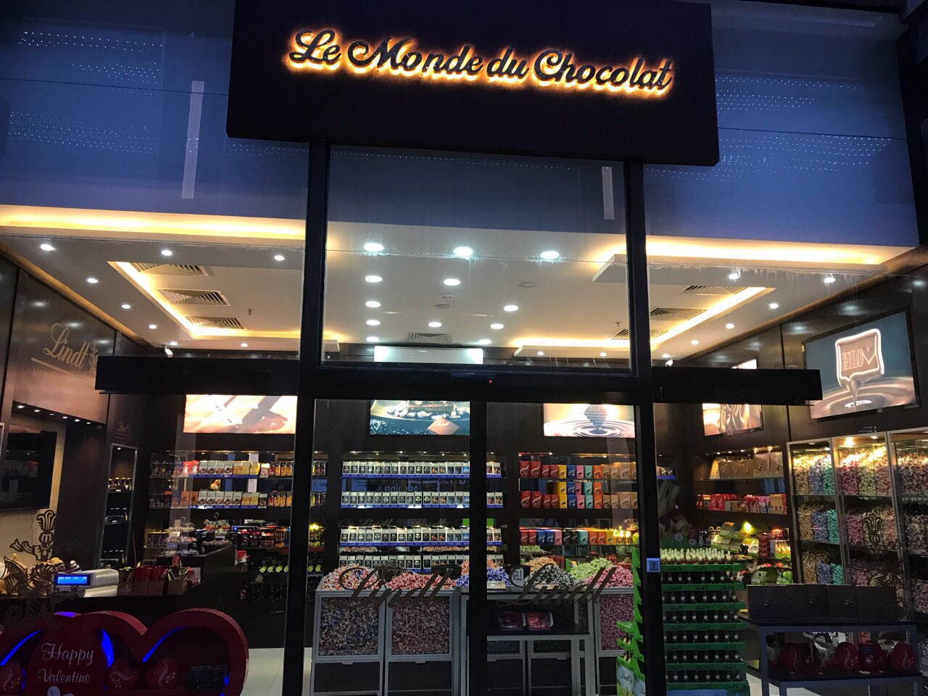
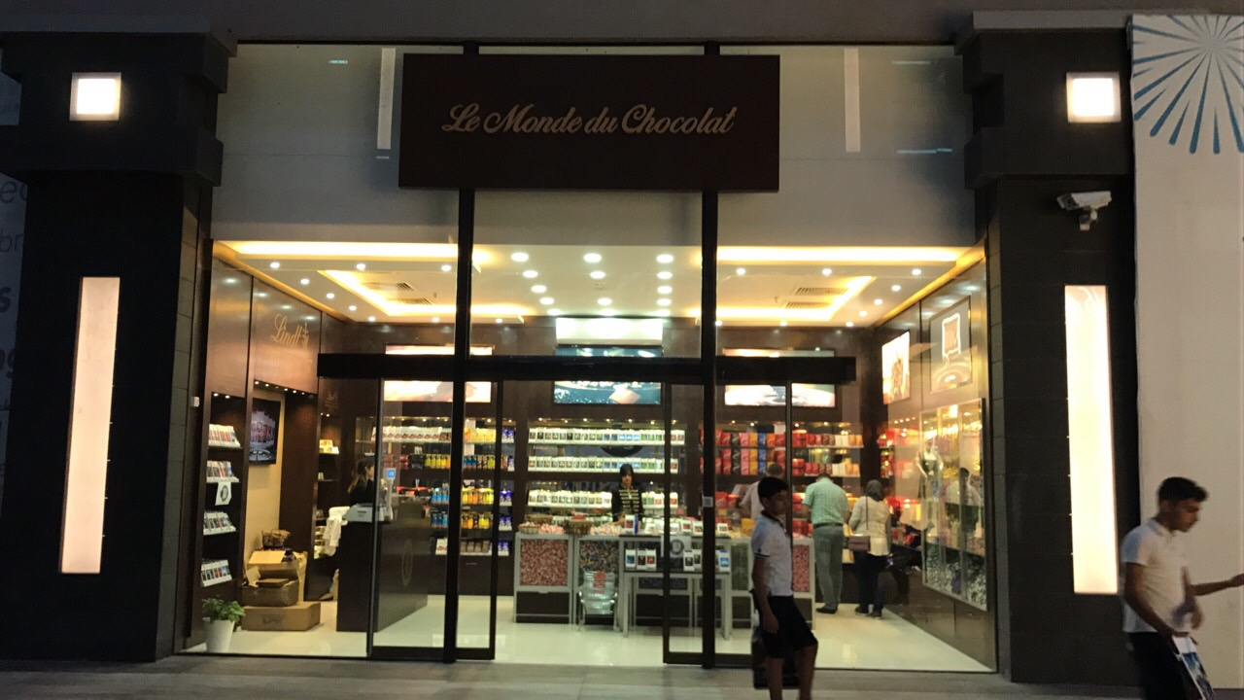
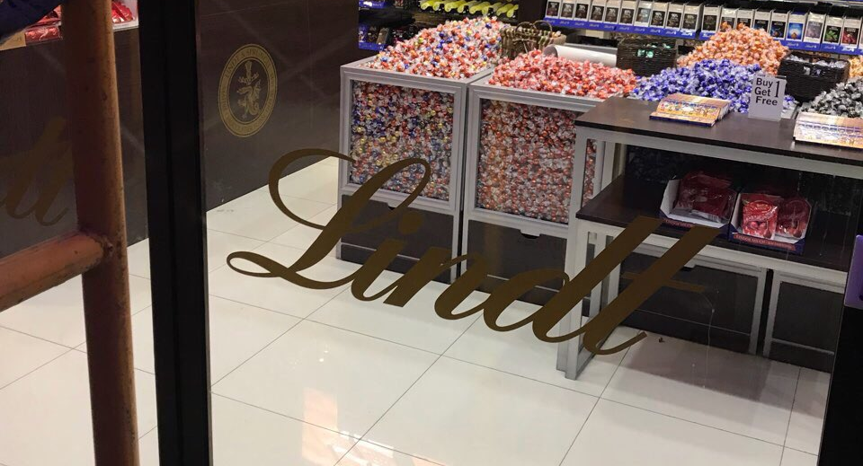
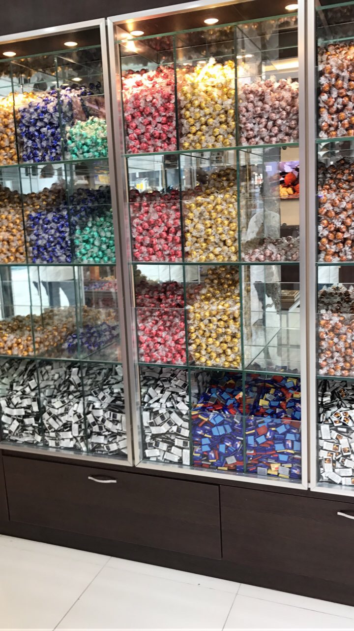
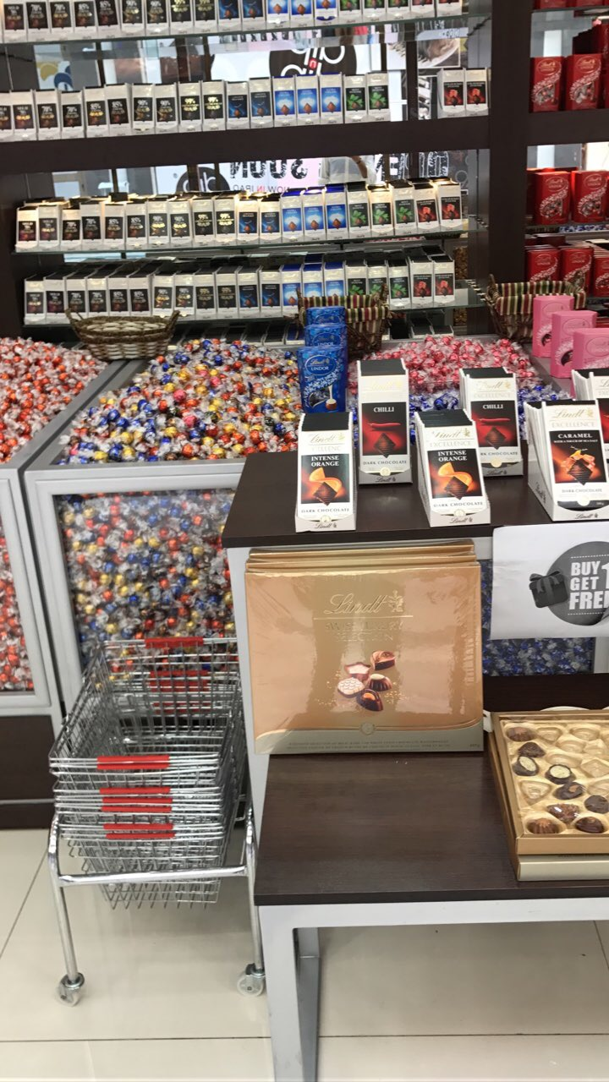
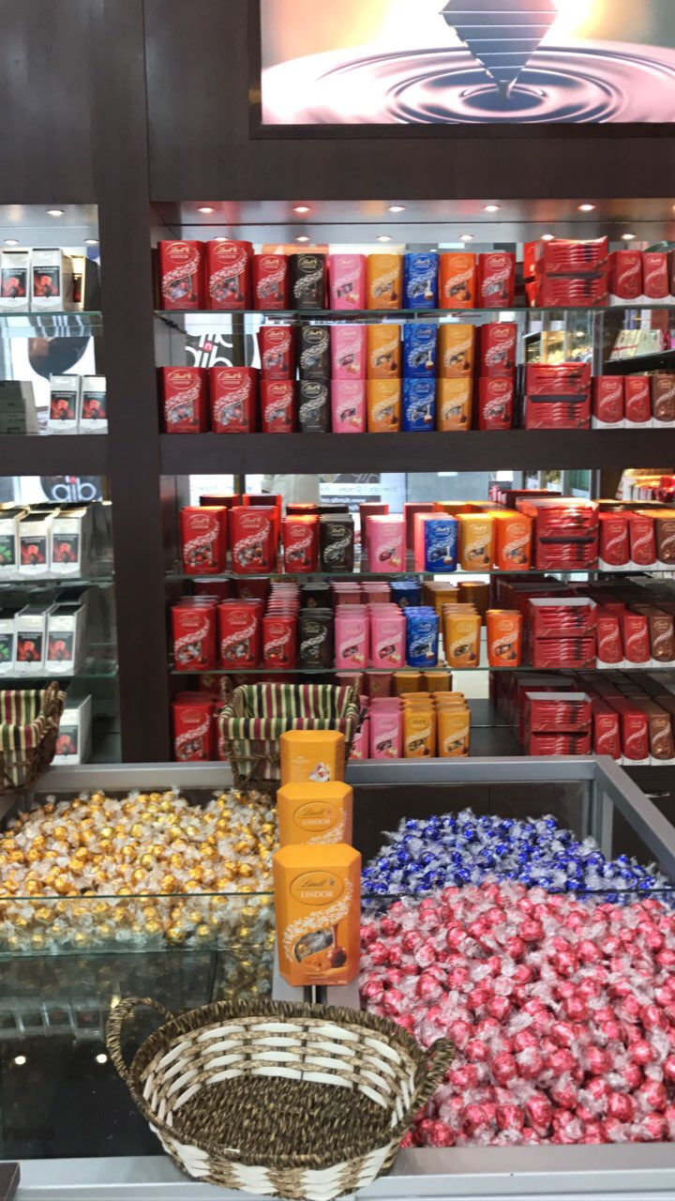
Le Monde du Chocolat

Slide 16
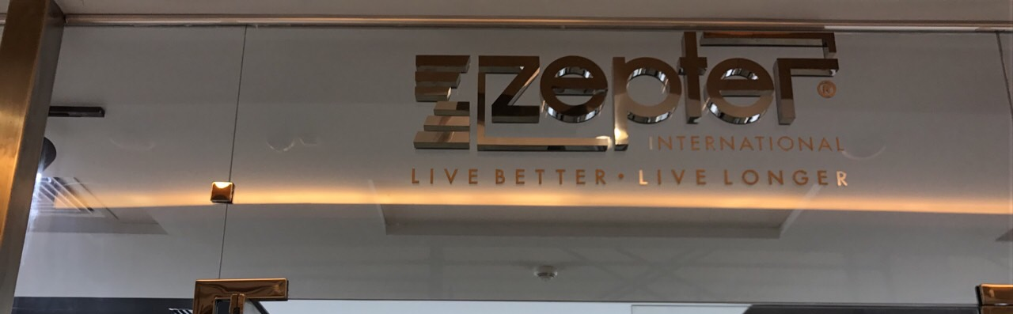
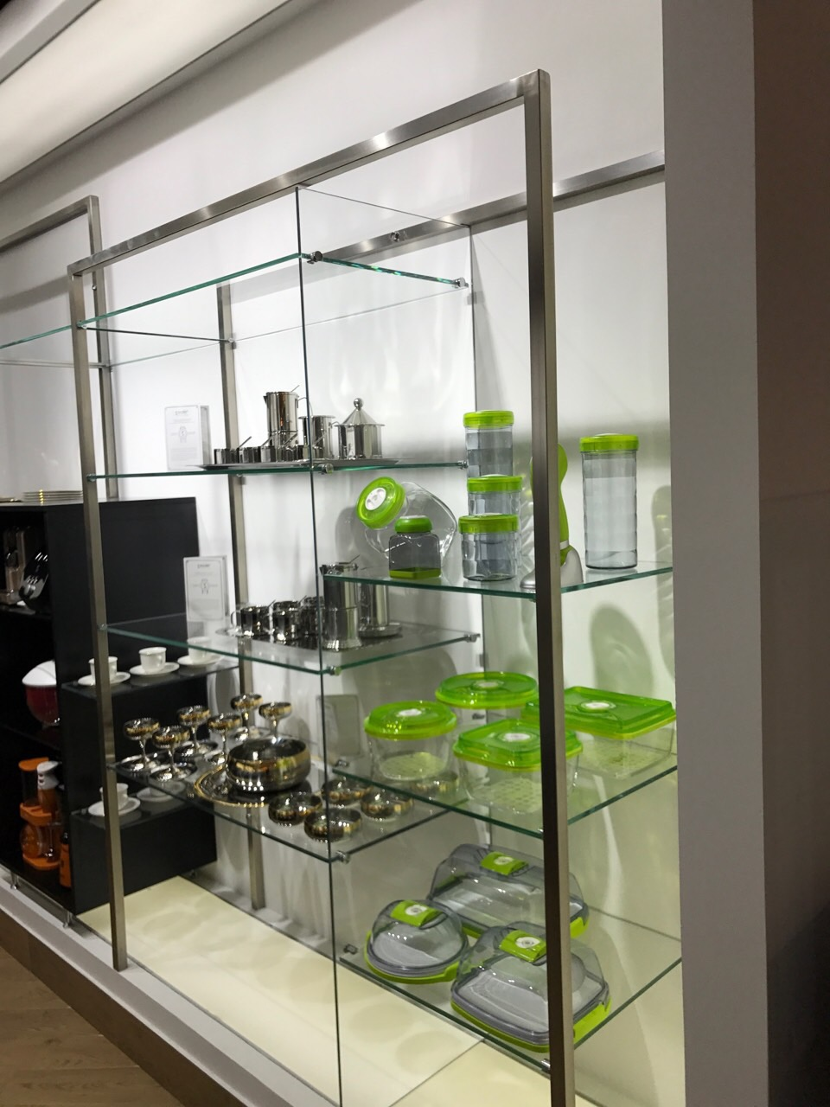
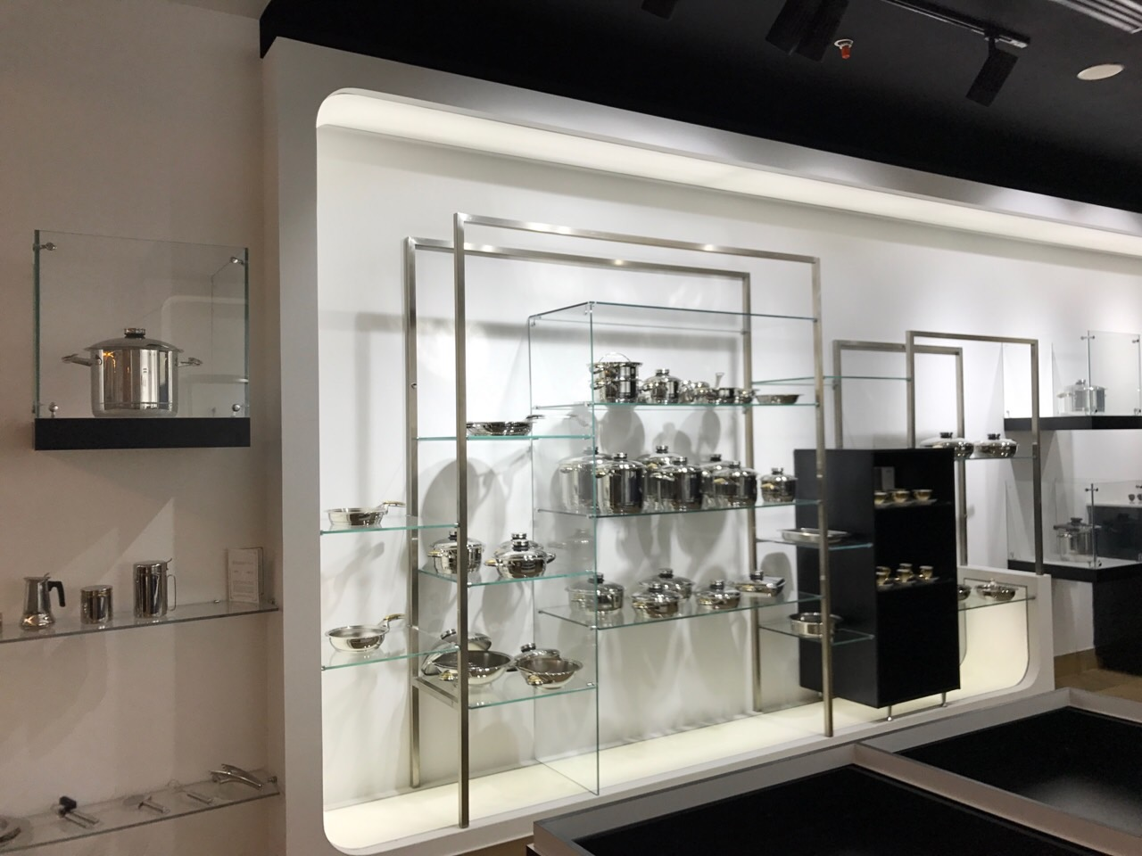
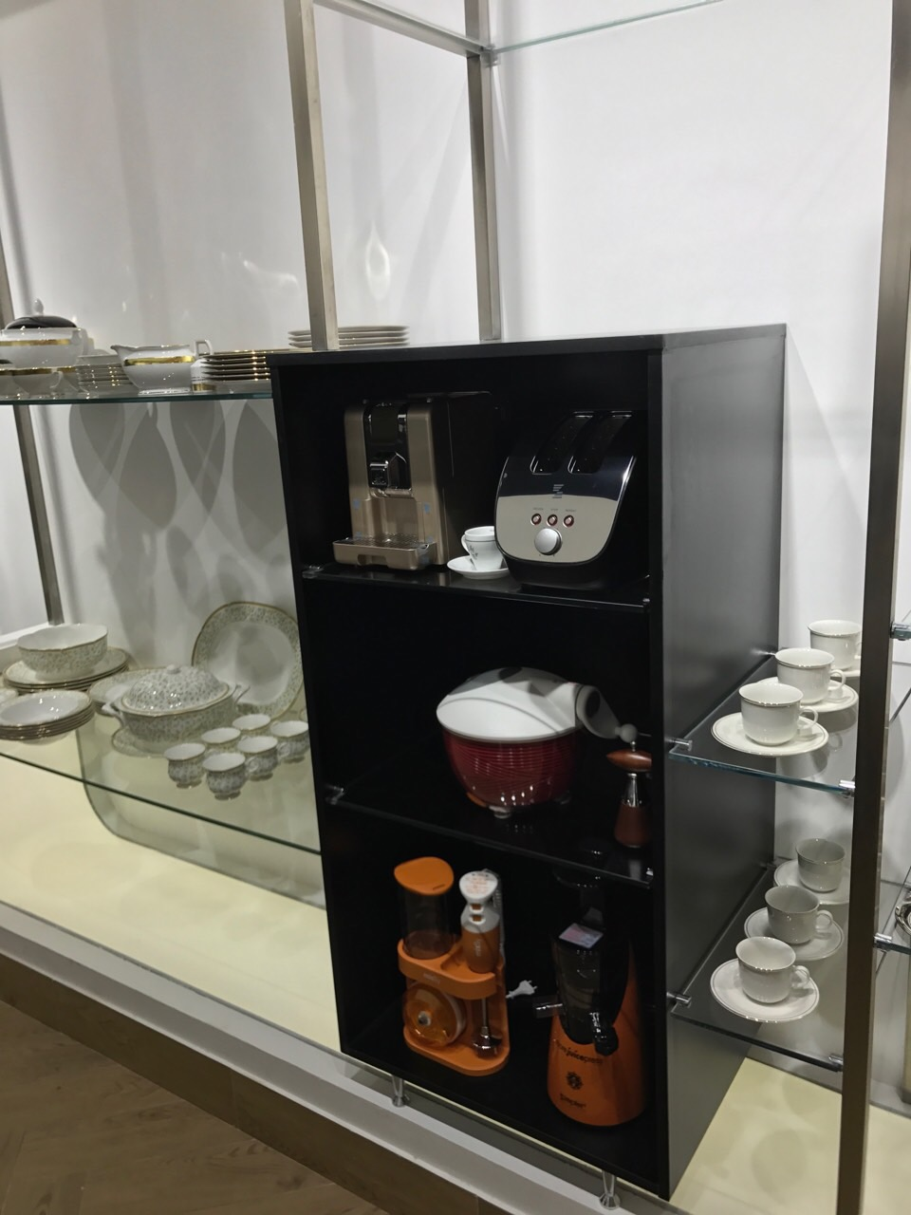
Zepter

Slide 17



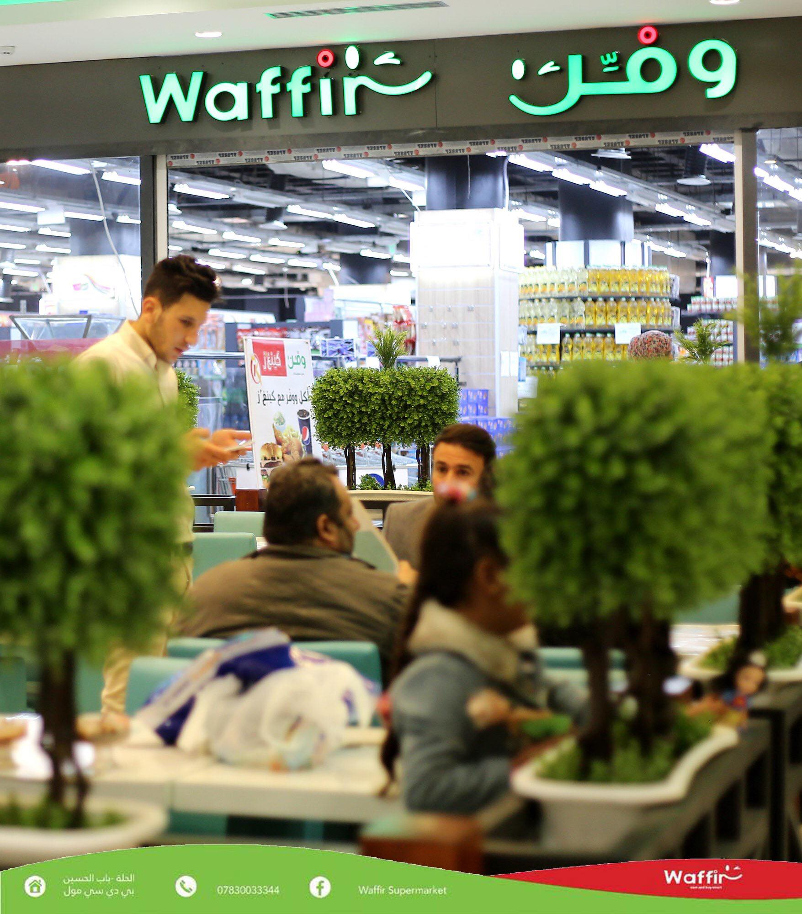
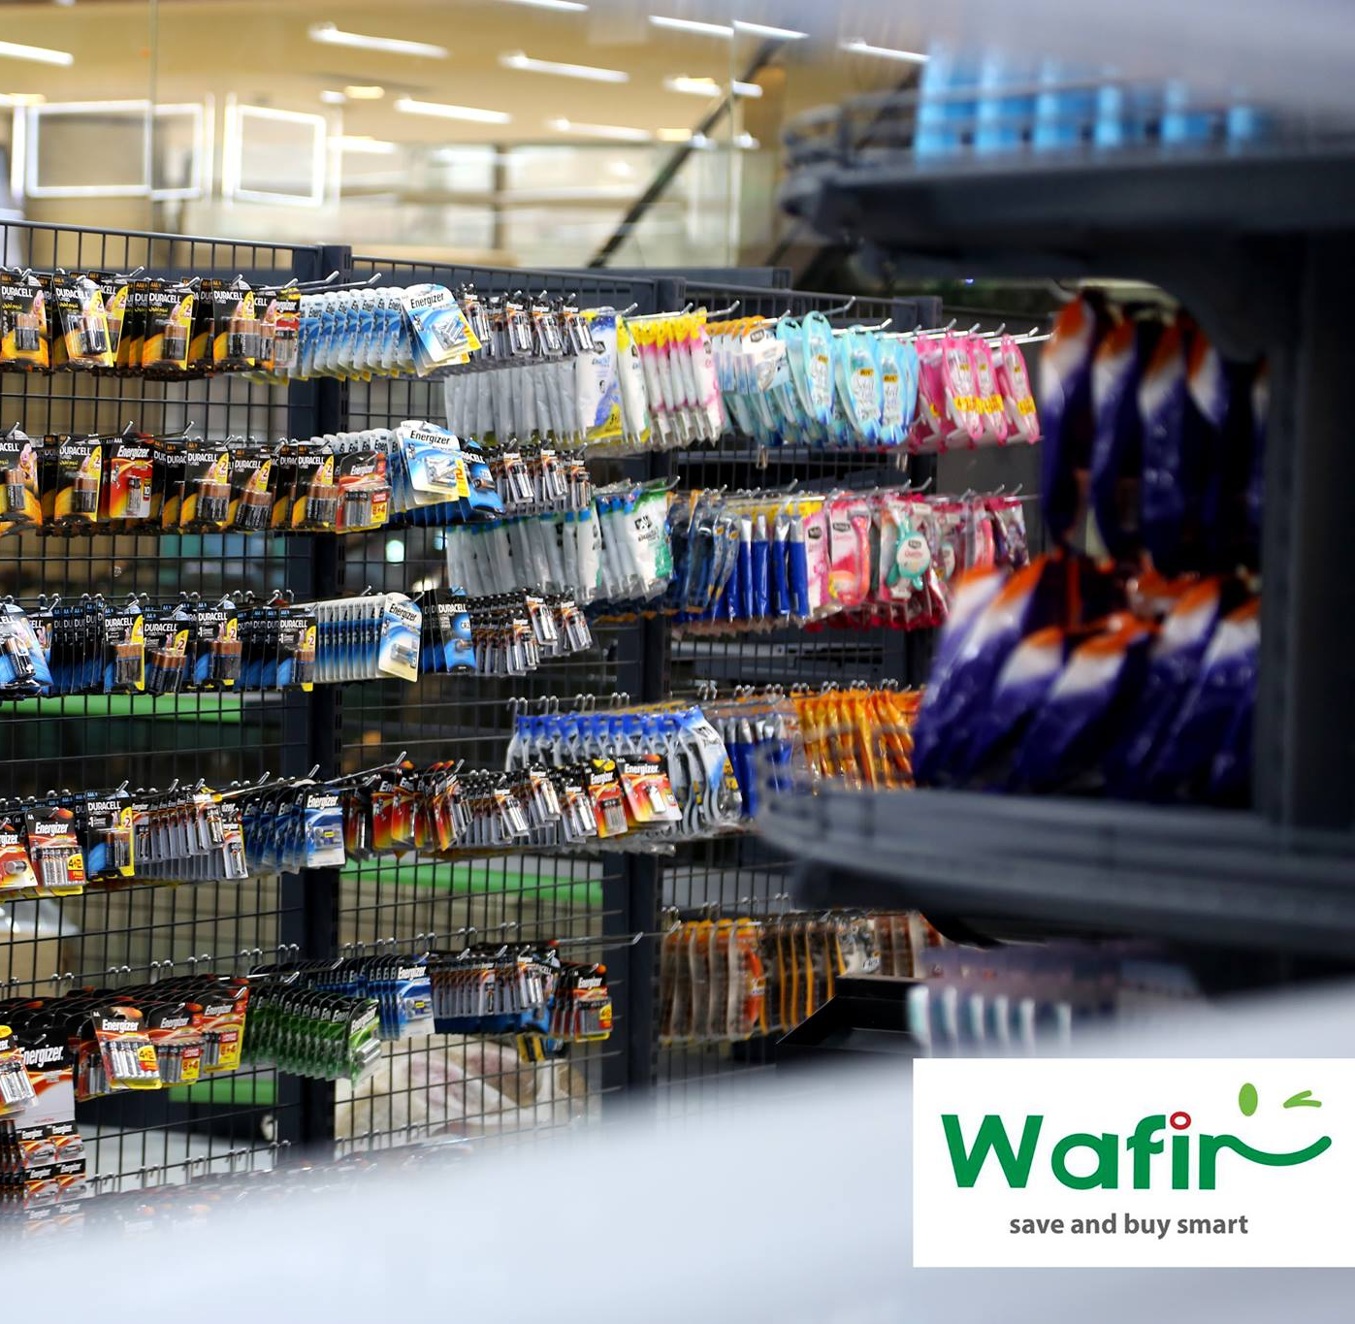
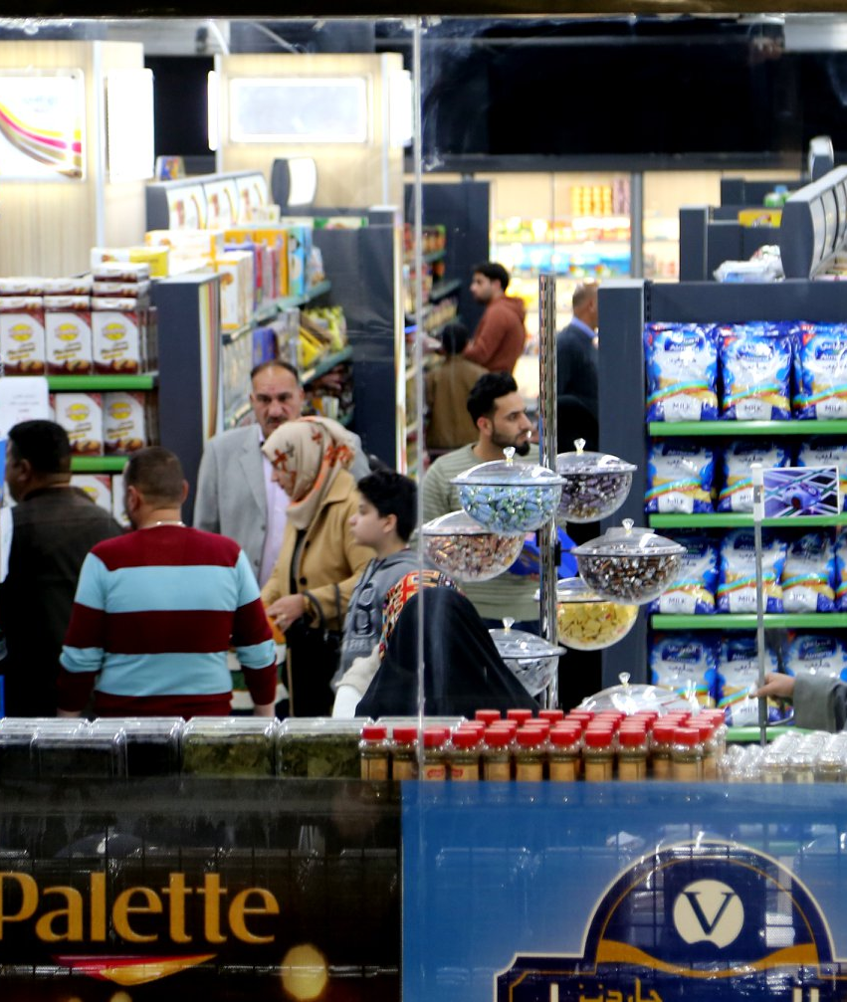
Waffir Supermarket

Slide 18
Thank You

